Slide 1
Microcontroller
8051

Slide 2
What is microcontroller?
A Microcontroller is a small and low-cost microcomputer
It is designed to perform the specific tasks of embedded systems like displaying information, receiving remote signals etc.
The general microcontroller consists of the processor, the memory (RAM, ROM, EPROM), Serial ports, peripherals (timers, counters) etc.

Slide 3
Types of Microcontrollers
Based on bit configuration, the microcontroller is divided into three categories.
8-bit microcontroller
This type of microcontroller is used to execute arithmetic and logical operations like addition, subtraction, multiplication division
For example, Intel 8031 and 8051 are 8-bit microcontroller.
16-bit microcontroller
This type of microcontroller is used to perform arithmetic and logical operations where higher accuracy and performance is required.
For example, Intel 8096 is a 16-bit microcontroller.
32-bit microcontroller
This type of microcontroller is generally used in automatically controlled appliances like automatic operational machines, medical appliances, etc.

Slide 4
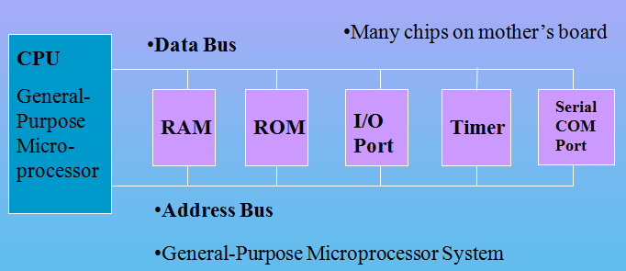
Microprocessor Based System
CPU
External RAM, ROM, I/O (No internal RAM, ROM, I/O ports in the CPU)

Slide 5
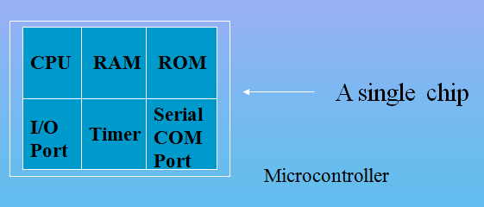
Microcontroller
A smaller computer on a CHIP
On-chip RAM, ROM, I/O Ports, Timer, Serial Controller
Example: Motorola’s 6811, Intel’s 8051, Atmel 32

Slide 6
Microprocessor vs. Microcontroller
Microprocessor
CPU is stand-alone, RAM, ROM, I/O, timer are separate
Designer can decide on the amount of ROM, RAM and I/O ports.
Expensive
Versatility
General-purpose
Microcontroller
CPU, RAM, ROM, I/O and timer are all on a single chip
Fixed amount of on-chip ROM, RAM, I/O ports.
Not Expensive
Single-purpose
Special Purpose.

Slide 7
μC based Embedded Systems
Special purpose computer system usually completely inside the device it controls
Has specific requirements and performs pre-defined tasks
Cost reduction compared to general purpose processor

Slide 8
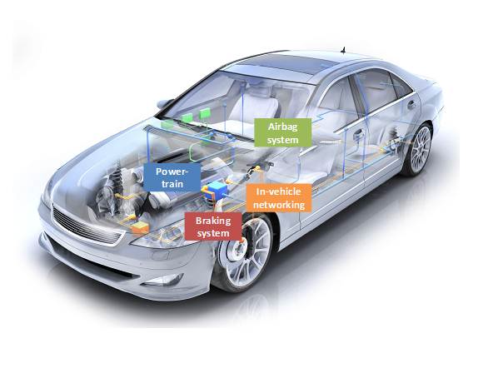
Embedded Systems Examples

Slide 9
8051 CPU Operation
Pin Diagram
Block Diagram

Slide 10
8051 Microcontroller
Intel introduced 8051, referred as MCS- 51, in 1981.
The 8051 is an 8-bit processor
The CPU can work on only 8 bits of data at a time.

Slide 11
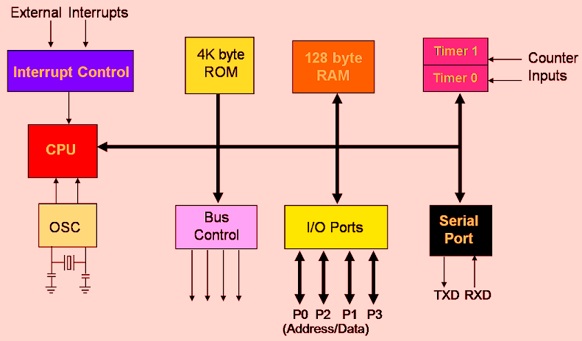
Block Diagram of 8051

Slide 12
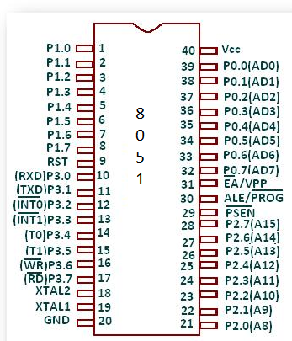
Pin Diagram

